Slide 1
Scientific Machine Learning for Modeling, Optimization, and Control of Dynamical Systems
Ján Drgoňa
Associate Professor Civil and Systems Engineering Department The Ralph O'Connor Sustainable Energy Institute (ROSEI)
Data Science and AI Institute (DSAI)

Slide 2
Course Syllabus
Week 1: Introduction to Scientific Machine Learning (SciML)
Week 2: Preliminaries and Introduction to differentiable programming
Week 3: Physics-informed neural networks (PINNs)
Week 4: Neural ordinary differential equations (NODEs)
Week 5: Learning to optimize (L2O)
Week 6: Optimal control preliminaries
Week 7: Learning to control (L2C)
Week 8: Feasibility restoration methods in L2O
Week 9: Neural differential equations with constraints
Week 10: Safety filters for L2C
Week 11: Predict then optimize: decision focused learning
Week 12: Project evaluation with presentations
Week 13: Project evaluation with presentations

Slide 3
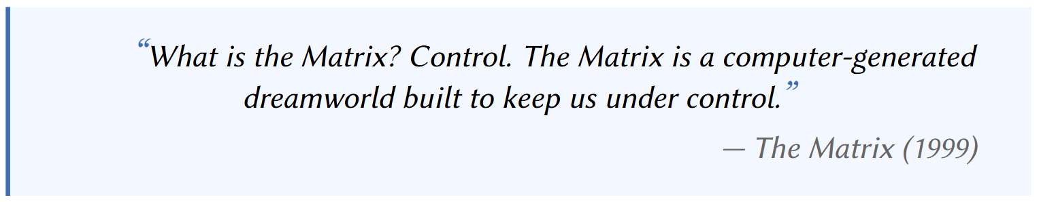

Learning to Control (L2C)
Nghiem T., Drgona J., et al. Physics-Informed Machine Learning for Modeling and Control of Dynamical Systems, ACC, 2023.
J. Drgoňa et al., "Safe Physics-informed Machine Learning for Dynamics and Control," 2025 American Control Conference (ACC), 2025.

Slide 4
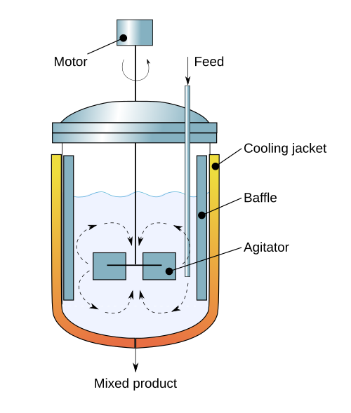
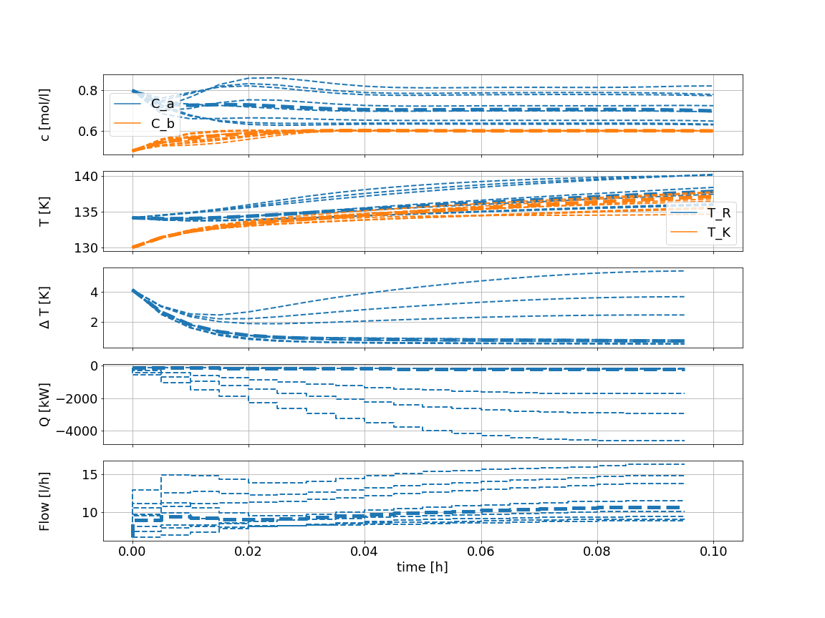
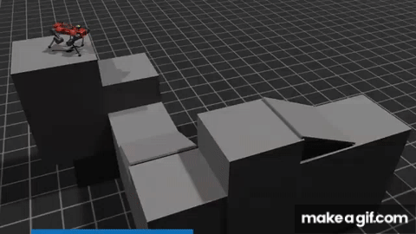
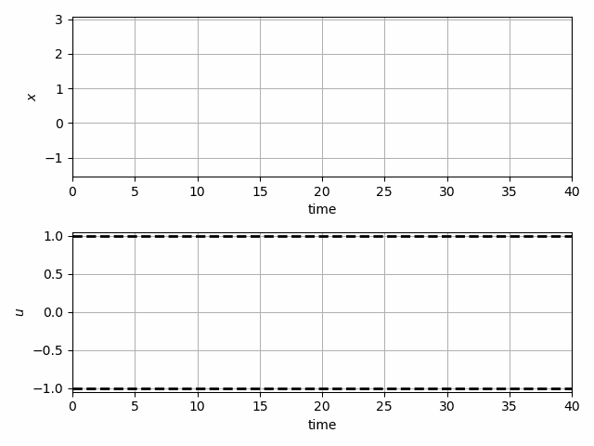
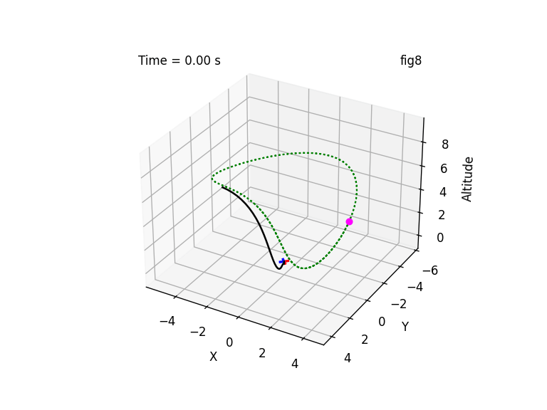
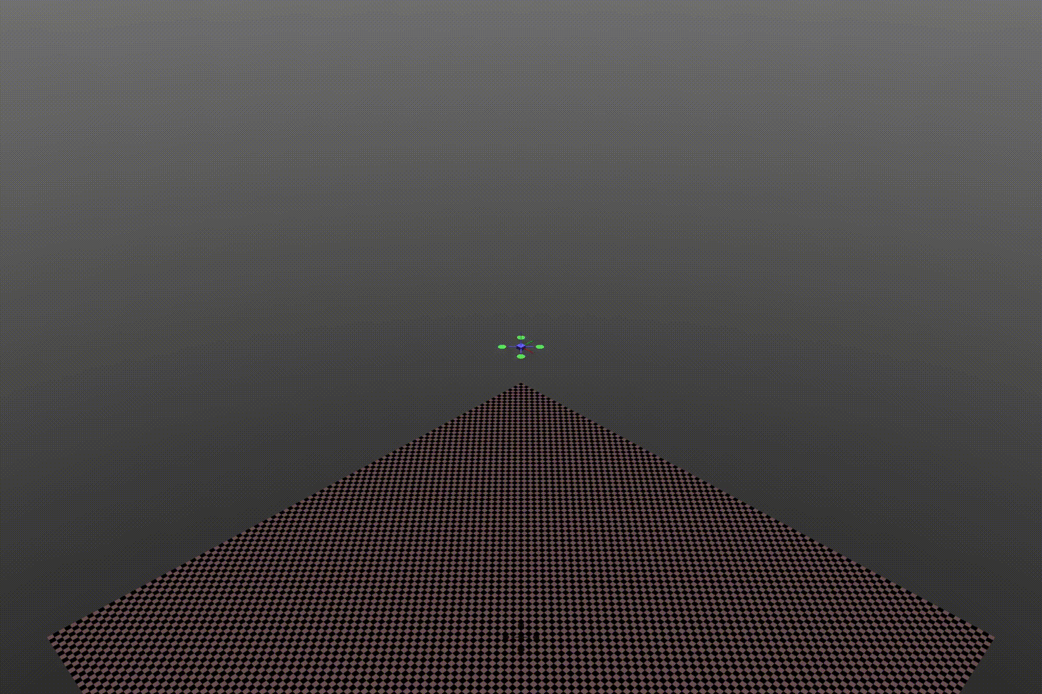
Learning to Control (L2C) Applications
Chemical process control
Robotics path planning and control
Trajectory optimization for dynamical systems
Quadcopter control

Slide 5
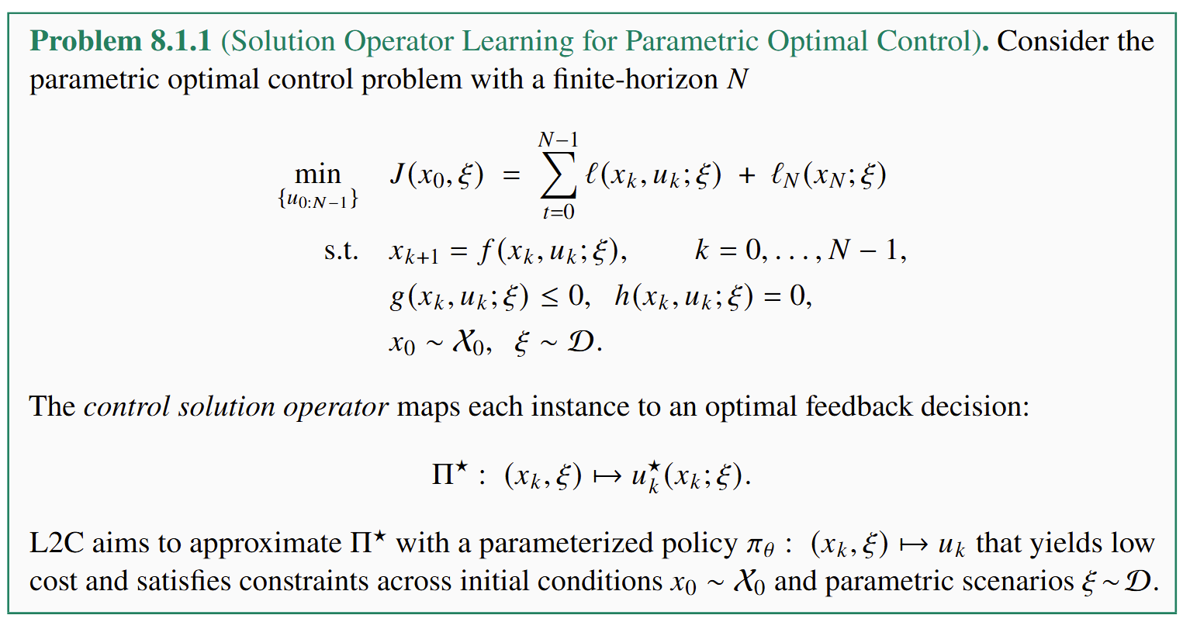
Learning to Control Problem Formulation

Slide 6
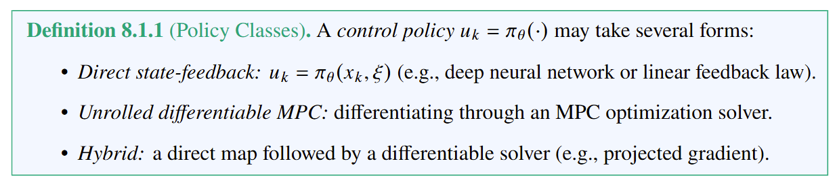
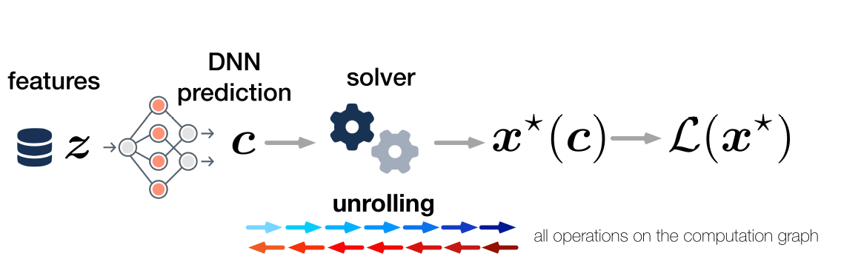
L2C Policy Representation
James Kotary, My H. Dinh, Ferdinando Fioretto, Backpropagation of Unrolled Solvers with Folded Optimization, IJCAI, 2023

Slide 7
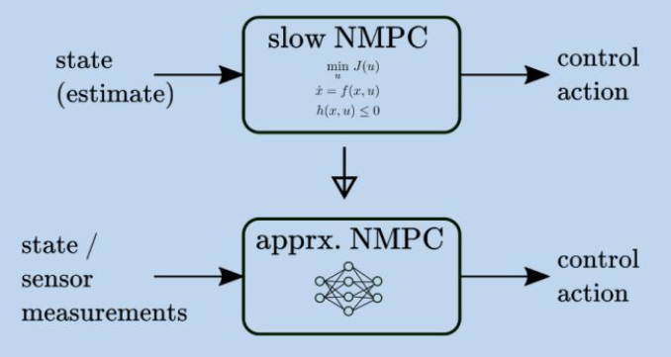
L2C Methodologies
Supervised L2C: Approximate Model Predictive Control
M. Hertneck, et al., "Learning an Approximate Model Predictive Controller With Guarantees," in IEEE Control Systems Letters, 2018
B. Karg and S. Lucia, "Efficient Representation and Approximation of Model Predictive Control Laws via Deep Learning," in IEEE Transactions on Cybernetics, 2020
Self-Supervised L2C: Differentiable Predictive Control (DPC)
J. Drgoňa, A. Tuor and D. Vrabie, "Learning Constrained Parametric Differentiable Predictive Control Policies With Guarantees," in IEEE Transactions on Systems, Man, and Cybernetics: Systems, 2024
Ján Drgoňa, et al, Differentiable predictive control: Deep learning alternative to explicit model predictive control for unknown nonlinear systems, Journal of Process Control, 2022

Slide 8
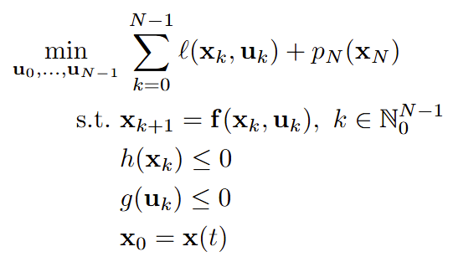
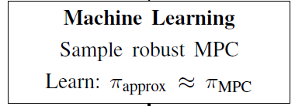
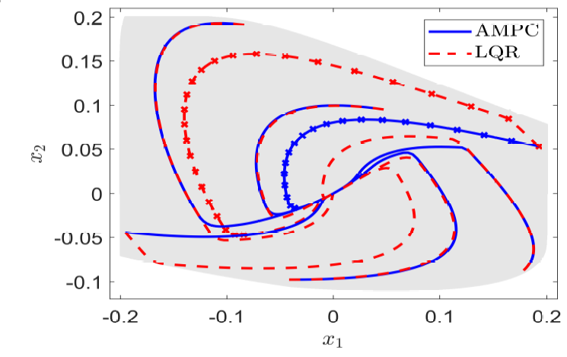




Supervised L2C: Approximate MPC
Step 1: solve set of MPC problems to generate labeled training data
Step 2: supervised imitation learning to learn approximate MPC policy
M. Hertneck, et al., "Learning an Approximate Model Predictive Controller With Guarantees," in IEEE Control Systems Letters, 2018

Slide 9
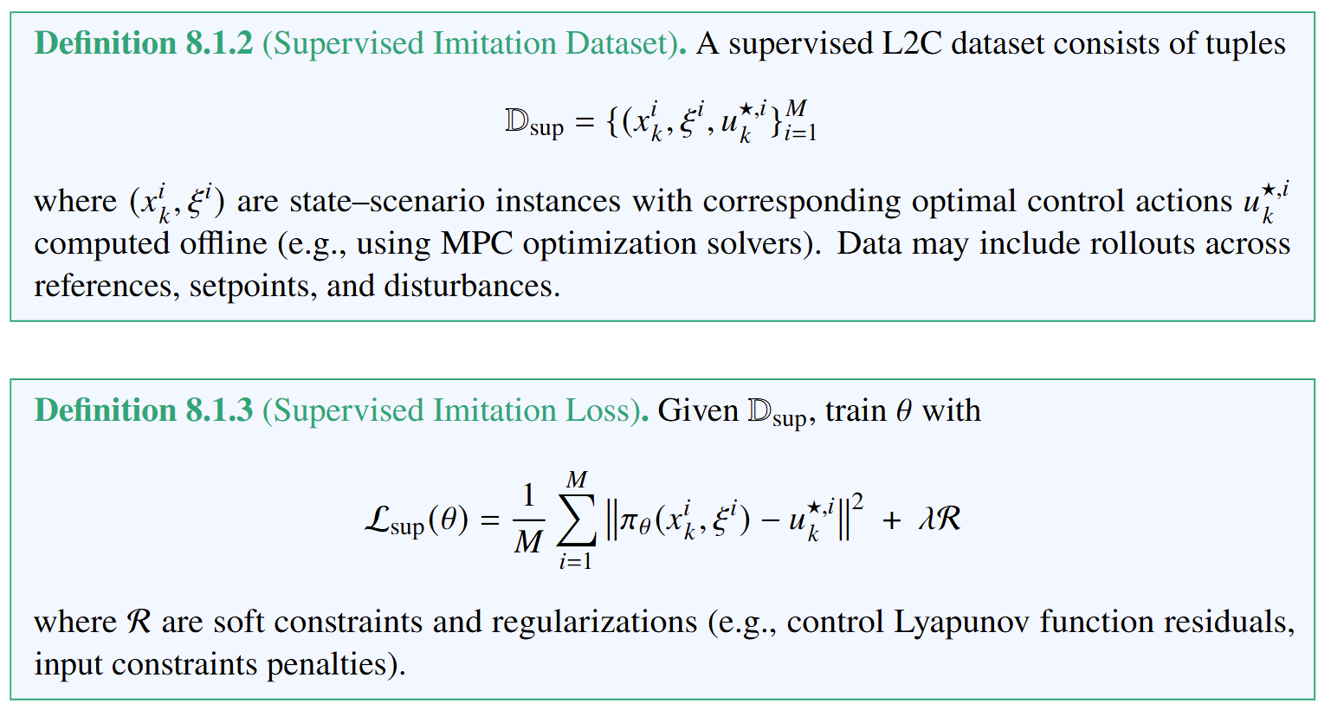
Supervised L2C Loss Function and Dataset
This is equivalent with supervised L2O method.

Slide 10
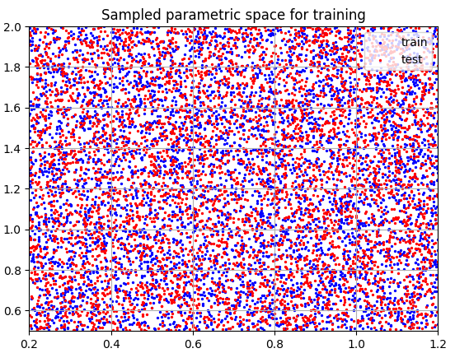
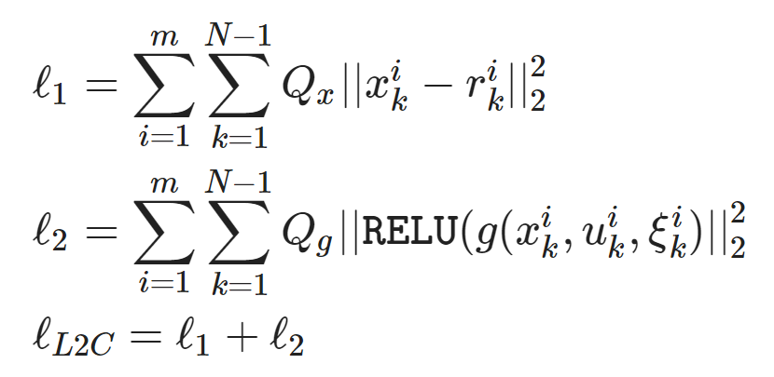
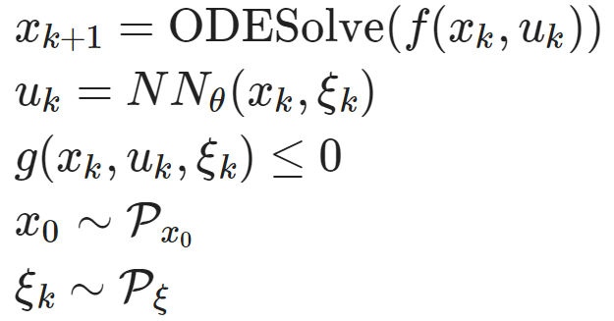
Self-Supervised L2C: Differentiable Predictive Control (DPC)
Dataset: collocation points in the control parametric space.
Architecture: differentiable model with neural network control policy.
Loss function: reference tracking, constraints and terminal penalties.
https://github.com/pnnl/neuromancer/blob/master/examples/control/Part_3_ref_tracking_ODE.ipynb
J. Drgoňa, A. Tuor and D. Vrabie, "Learning Constrained Parametric Differentiable Predictive Control Policies With Guarantees," in IEEE Transactions on Systems, Man, and Cybernetics: Systems, 2024

Slide 11
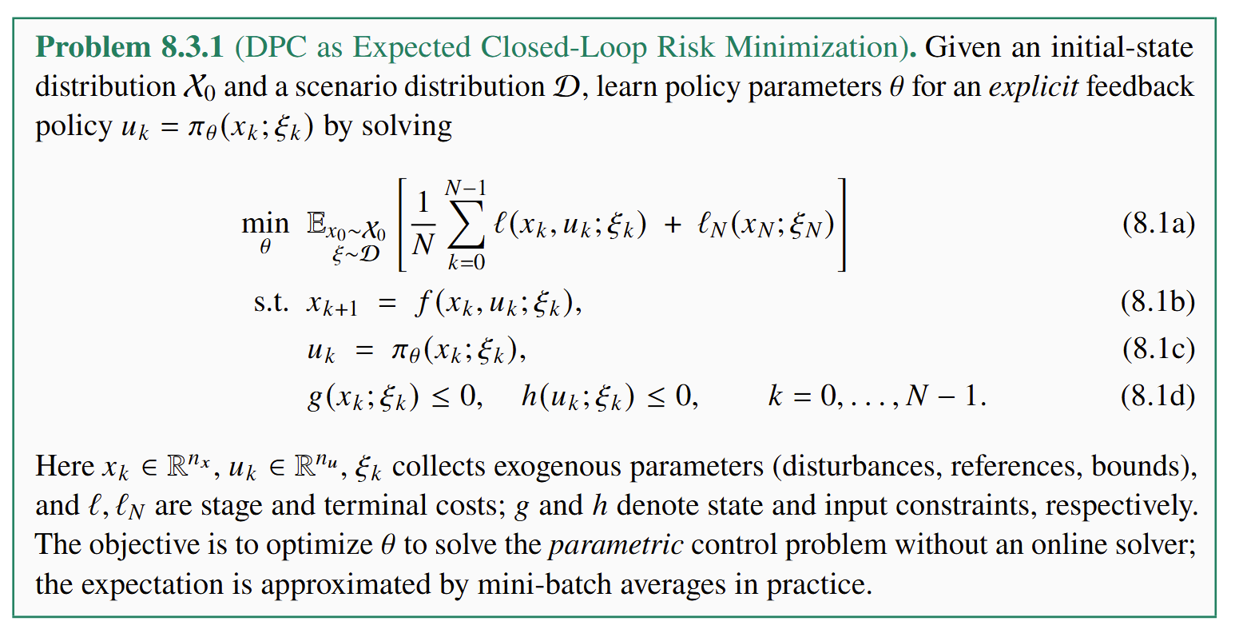
DPC Problem Formulation

Slide 12
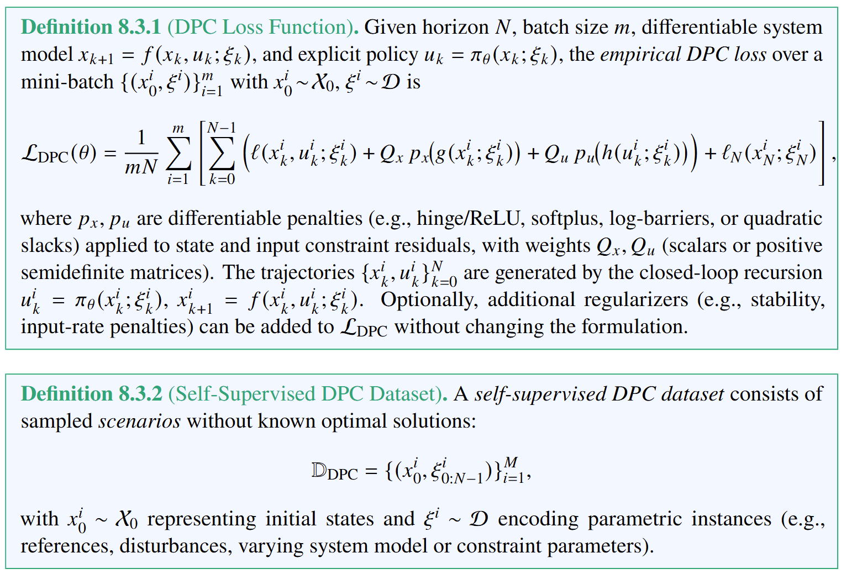
DPC Loss Function and Dataset

Slide 13
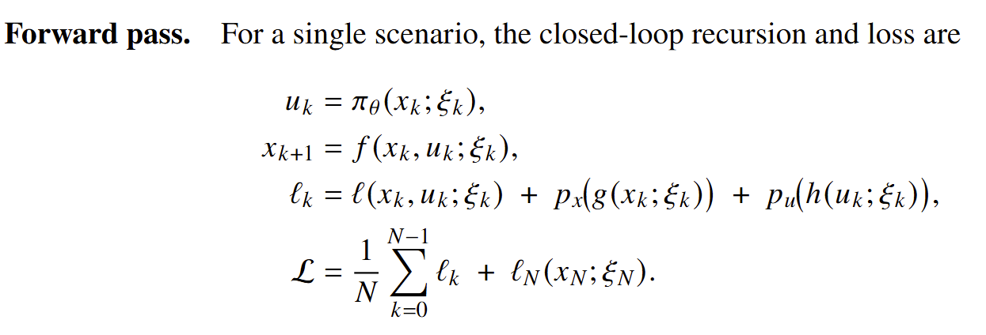
Differentiable Closed-Loop System

Slide 14
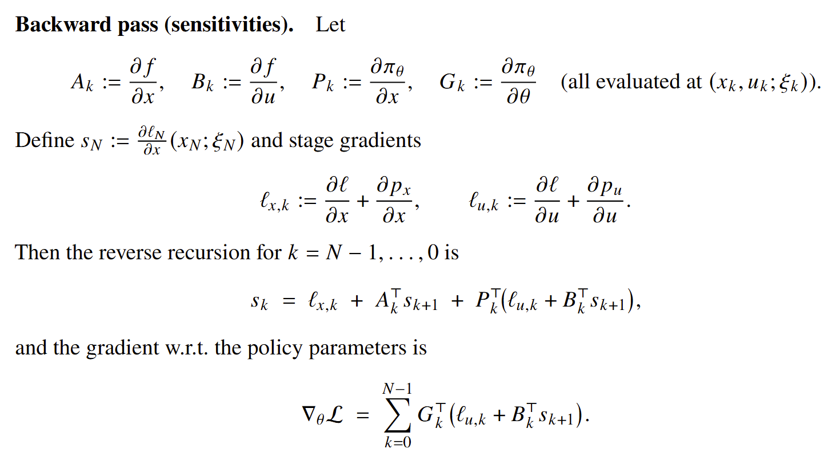
Differentiable Closed-Loop System

Slide 15
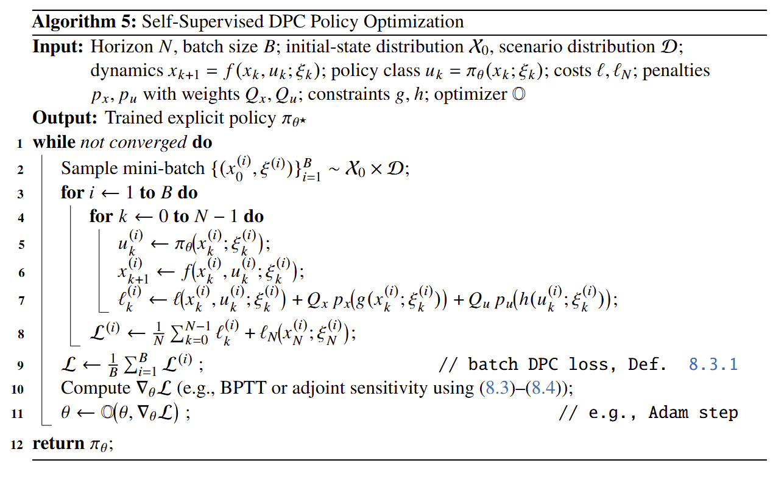
DPC Policy Optimization Algorithm

Slide 16
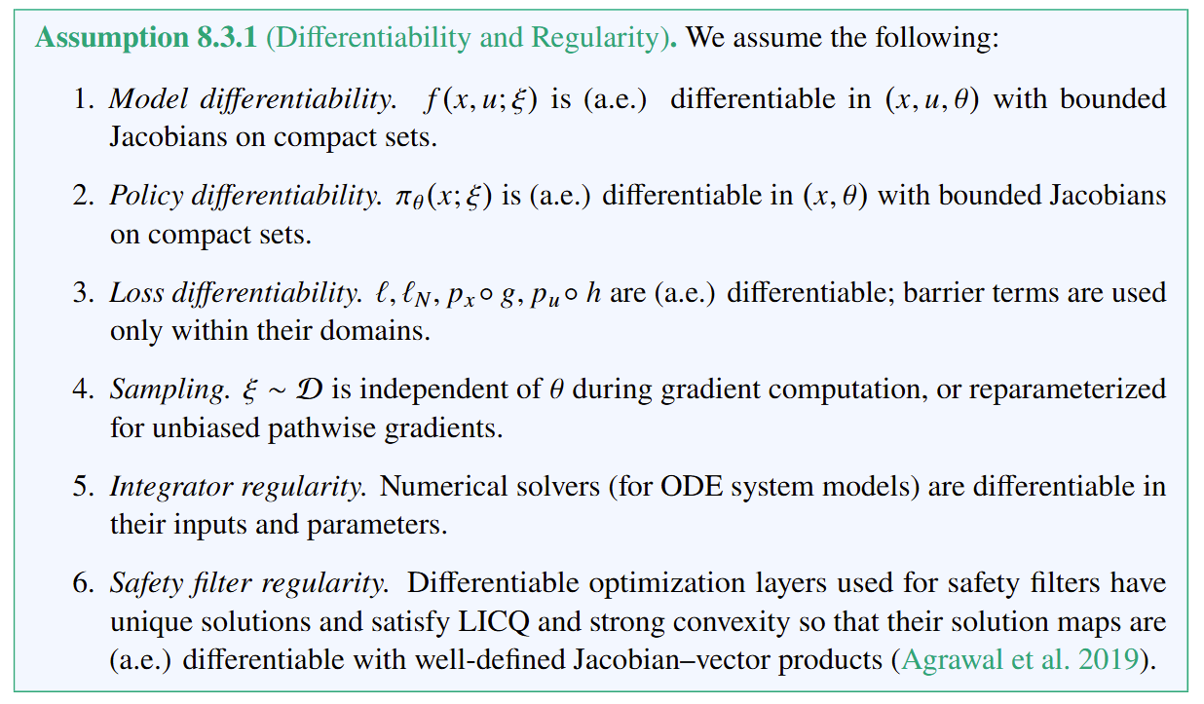
DPC Assumptions

Slide 17
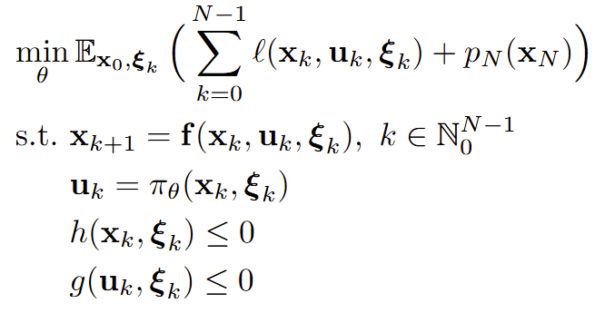
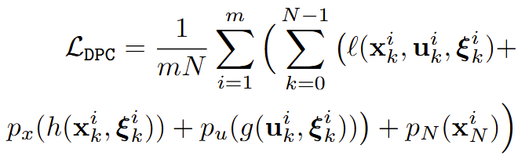
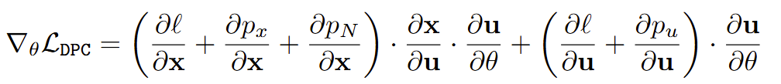
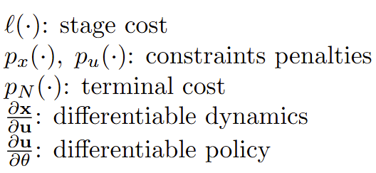
DPC vs Model-based Reinforcement Learning
DPC is closely related to MBRL in that both leverage model of dynamics, but DPC utilizes differentiable closed-loop models and cost functions, allowing direct policy gradients without requiring a learned critic.
Empirical risk minimization problem:
Critic parametrized by differentiable MPC-like loss function:
Policy gradient via automatic differentiation:
J. Drgoňa, A. Tuor and D. Vrabie, Learning Constrained Parametric Differentiable Predictive Control Policies With Guarantees, in IEEE Transactions on Systems, Man, and Cybernetics: Systems, 2024
J. Drgoňa, et al., Differentiable Predictive Control: An MPC Alternative for Unknown Nonlinear Systems using Constrained Deep Learning, Journal of Process Control, 2022

Slide 18
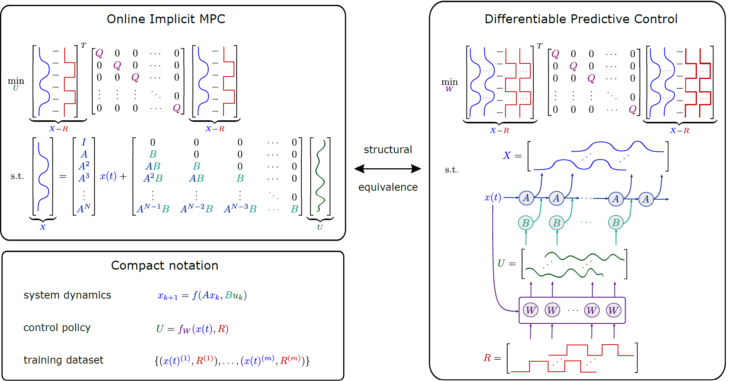
DPC vs Model Predictive Control
DPC is also closely related to MPC, but instead of single instance online optimization, the DPC learns parametric explicit policy offline, over distribution of parametric instance.
There is a structural equivalence between single shooting formulation of MPC problem and the unrolled closed-loop system dynamics in DPC.
DPC is also related to explicit MPC, as it solves a parametric optimal control problem via gradient-based policy optimization.
J. Drgoňa, A. Tuor and D. Vrabie, Learning Constrained Parametric Differentiable Predictive Control Policies With Guarantees, in IEEE Transactions on Systems, Man, and Cybernetics: Systems, 2024
J. Drgoňa, et al., Differentiable Predictive Control: An MPC Alternative for Unknown Nonlinear Systems using Constrained Deep Learning, Journal of Process Control, 2022

Slide 19
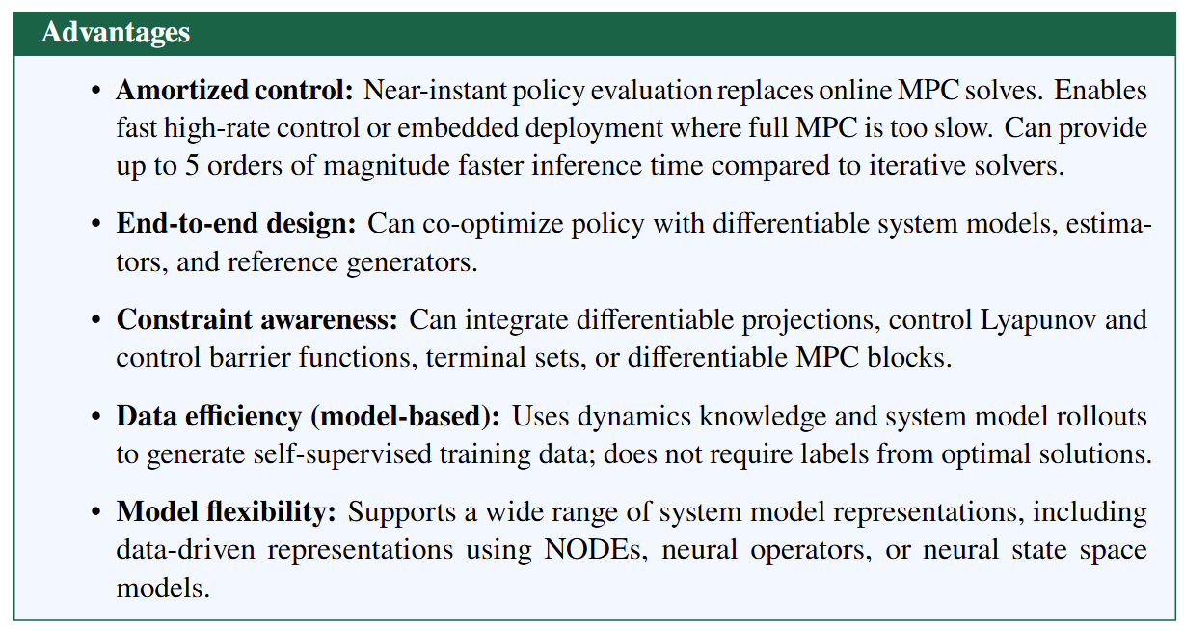
DPC Advantages

Slide 20
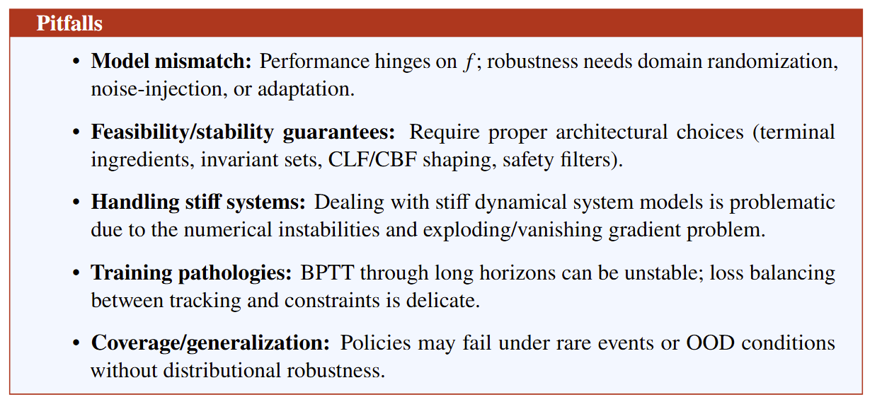
DPC Disadvantages

Slide 21

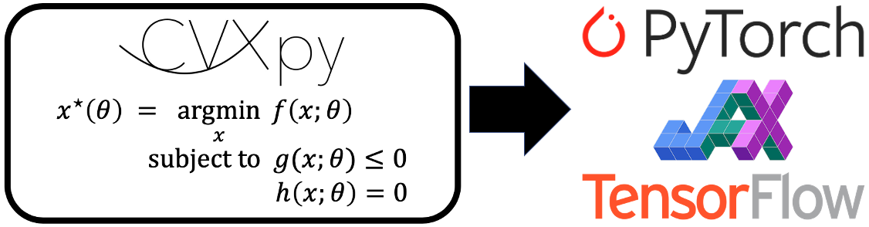


Learning to Control Libraries
github.com/cvxpy/cvxpylayers
https://github.com/MaxMSun/lqrax
github.com/pnnl/neuromancer
www.do-mpc.com/en/latest/index.html

Slide 22
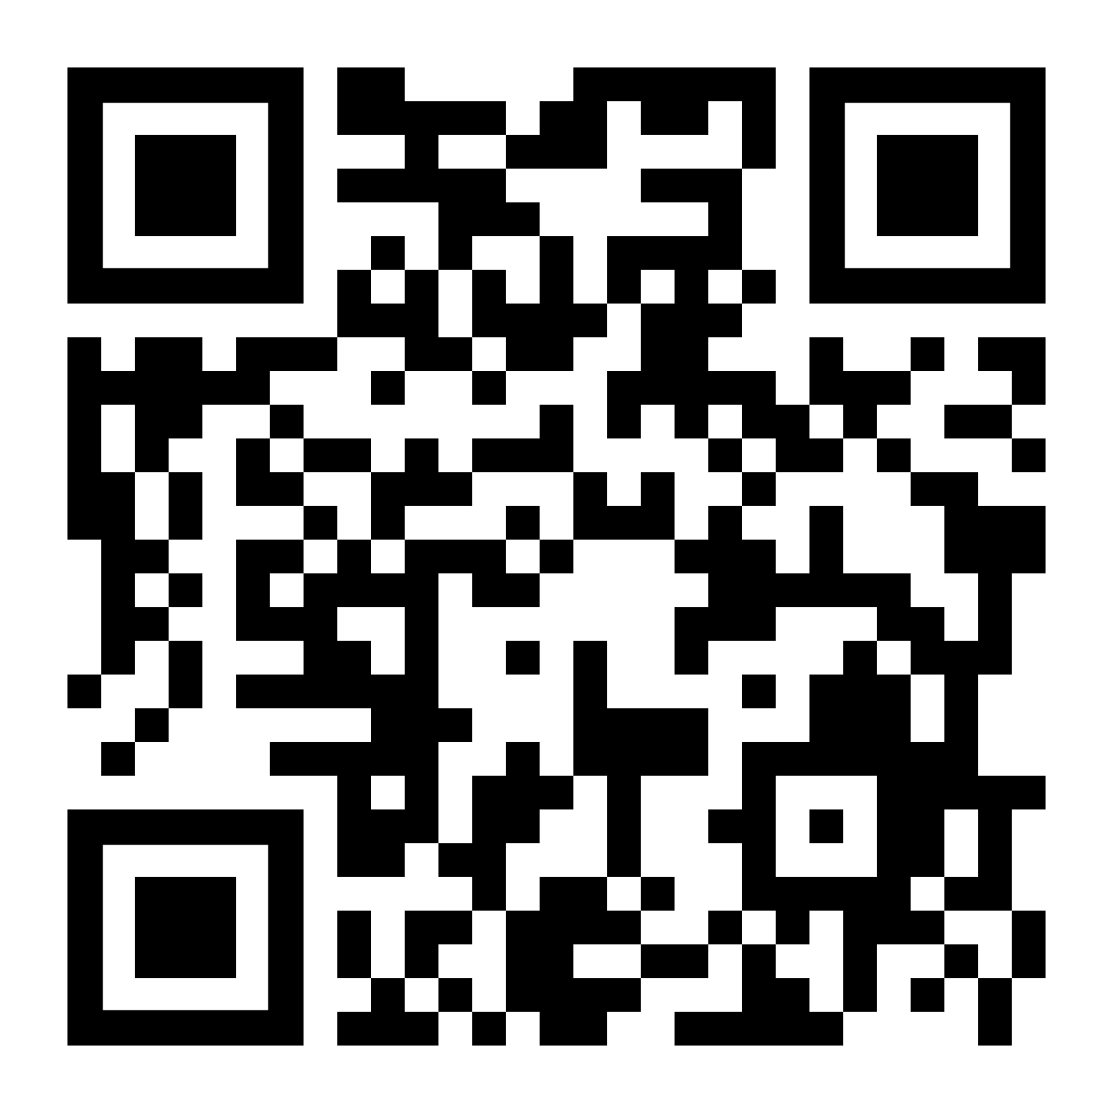
DPC in NeuroMANCER Scientific Machine Learning Library
DPC Examples
Learning to stabilize a linear dynamical system
Learning to stabilize a nonlinear differential equation.
Learning to control a nonlinear differential equation.
Learning neural ODE and control policy for an unknown dynamical system.
Learning neural Lyapunov function for a nonlinear dynamical system.
Mixed-Integer DPC
github.com/pnnl/neuromancer

Slide 23
Homework Assignment: Project Proposal
Project proposal: Who did not score 100 points, update your proposal based on the feedback.
The proposal must include following paragraphs:
Summary: Single sentence providing concise overview of the proposal.
Introduction: Provides context and problem statement. Answers what is the problem and why is the problem important.
Objectives: States clear and specific objectives of the proposal. Answers what we want to achieve.
Technical approach: Detailed explanation of how the project will be executed. Provides steps, strategies, and techniques to be used. Answers how are we going to achieve our objectives.
Expected outcomes: Key results expected from the project. Performance indicators and success metrics.

Slide 24
Week 11: Project Presentations and Evaluation
Projects cover 70% of the course grade!
Project proposal 20% - week 5
Project progress report 10% - week 8
Project final report 20% - week 10
Project presentation 20% - week 11
Project format.
Project technical report: 4 to 6 page long pdf document including references and figures.
Project presentation: ppt or pdf slides, 15 min time slot per student in week 11.
Admissible topics.
Application of selected SciML methods to problems inspired by real-world applications
e.g., L2O for large scale optimization of energy systems.
Development of new methods tackling some of the open challenges in SciML
e.g., novel way of utilizing PINNs in differentiable control for PDEs.
New theory supporting selected SciML methodology
e.g., convergence analysis of feasibility restoration layers in L2O.

